Slide 2
Project Overview
Admission on University is developed for the student who will be attend public university admission test.
Admission test attend can be who have minimum required (SSC & HSC Examination result ).
They will communicate with each other through our application.
User can make live communication under any test.
User can be incurred for any public university admission test of Bangladesh.
Admission on University is basically a web application which is currently built for online platform.
Track of university admission test over all university's.

Slide 3
Problem description
We have to struggle a lot to getting sturdy on public university.
All public university's published admission test schedule. Most often same season.
Therefor we saw that two university's admission test established same day or one day up and down.
Which student live in far way they cannot be sure where attend the test.

Slide 4
Object
Making online system where student can be know admission information all public university.
Building communication between the student and informer teachers.
We provided to suggestion where is the best place of required student.
We are tracking university admission test and given there.
So, The our motive is to create a online place where student can apply admission over all public university.

Slide 5
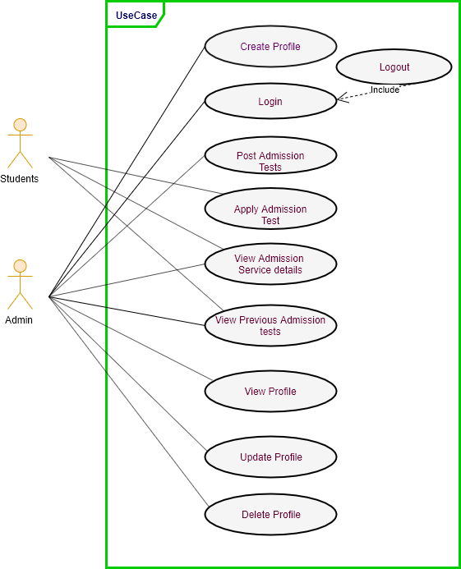
Use Case Diagram

Slide 6
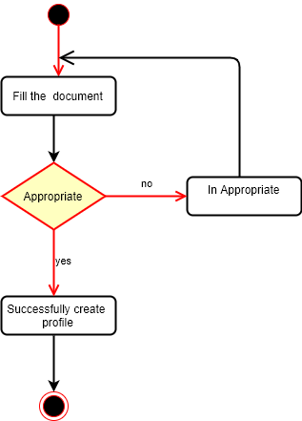
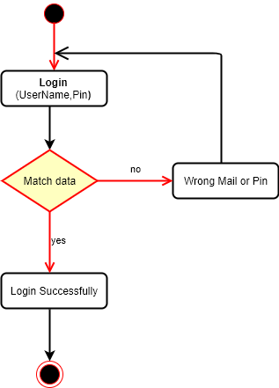
Activity diagram
Registration
Login

Slide 7
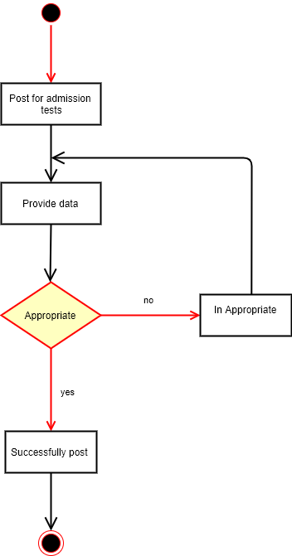
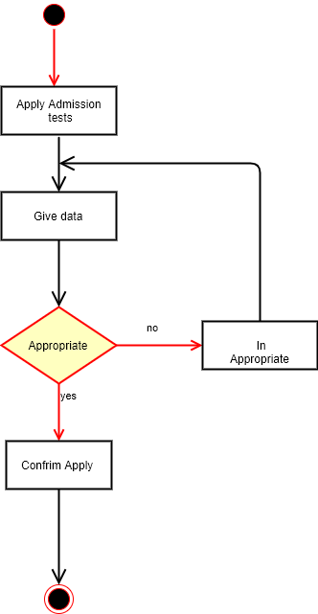
Activity diagram
Post Admission
Apply Admission

Slide 8
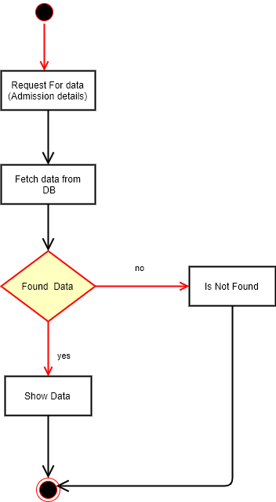
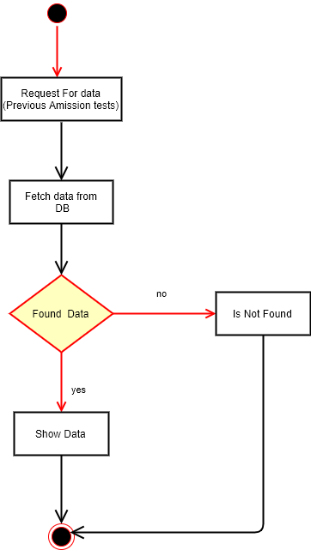
Activity diagram
View Admission
View Previous Post

Slide 9
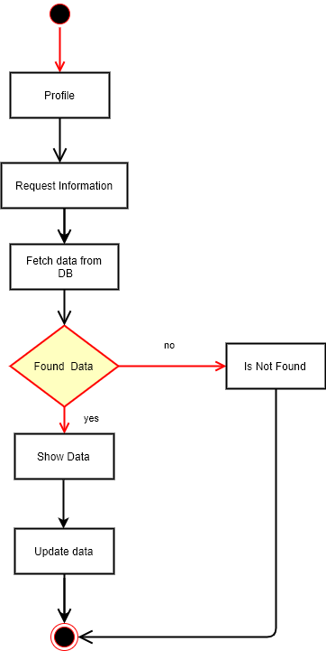
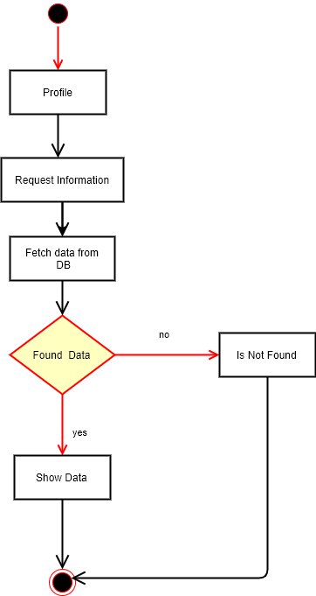
Activity diagram
Update
View Profile

Slide 10
Activity diagram
Delete Profile

Slide 11
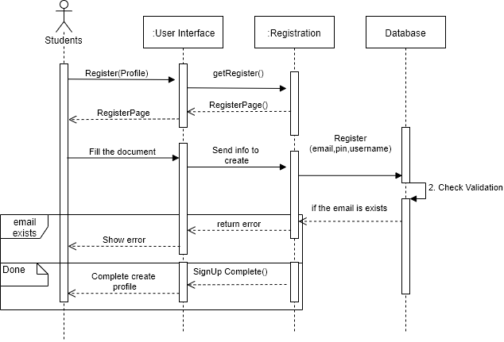
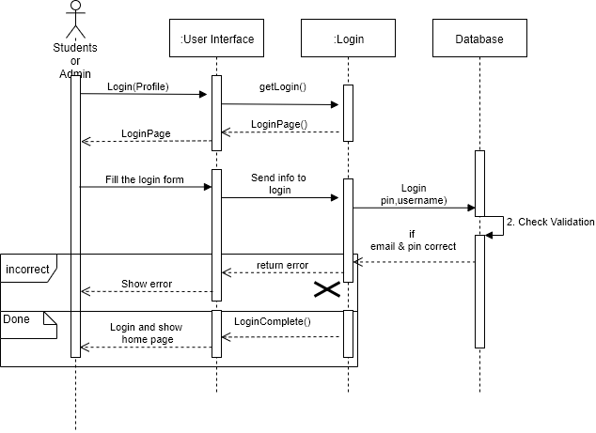
Sequence diagram
Registration Profile
Login Profile

Slide 12
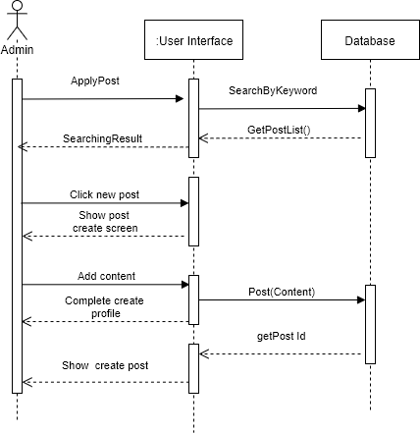
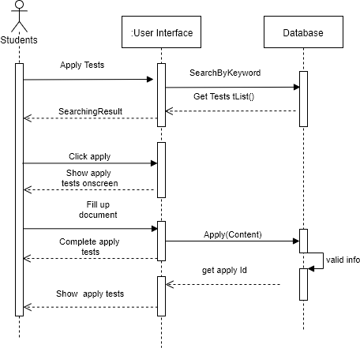
Sequence diagram
Post Admission
Apply Admission

Slide 13
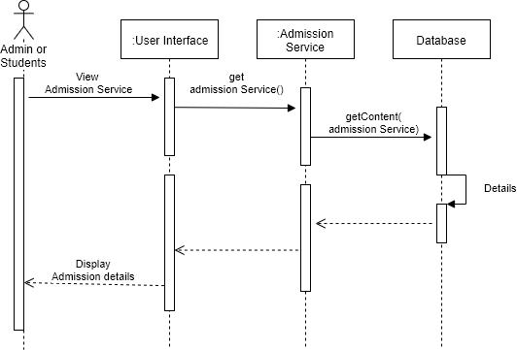
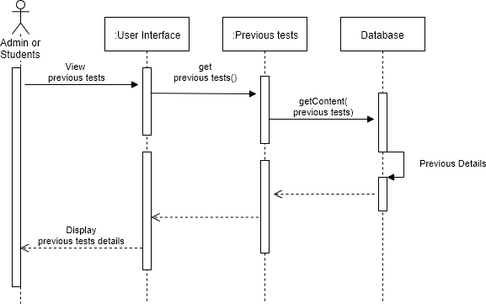
Sequence diagram
View Admission
View Admission Previous

Slide 14
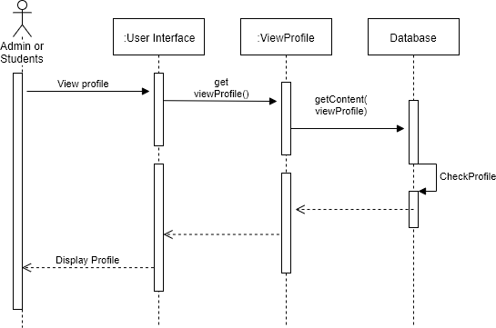
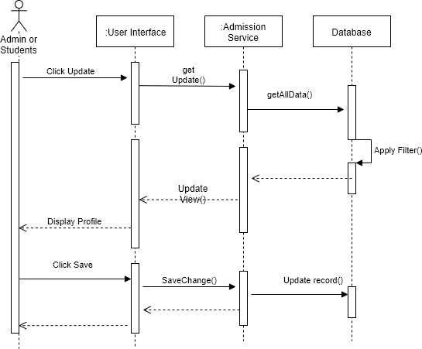
Sequence diagram
View Profile
Update Profile

Slide 15
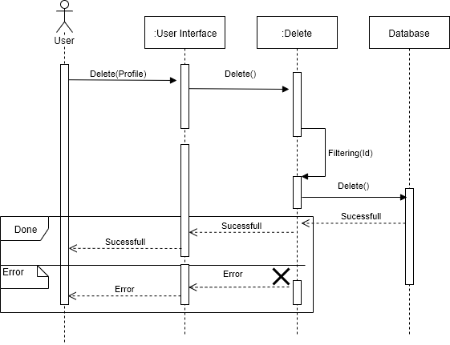
Sequence diagram
Delete Profile

Slide 16
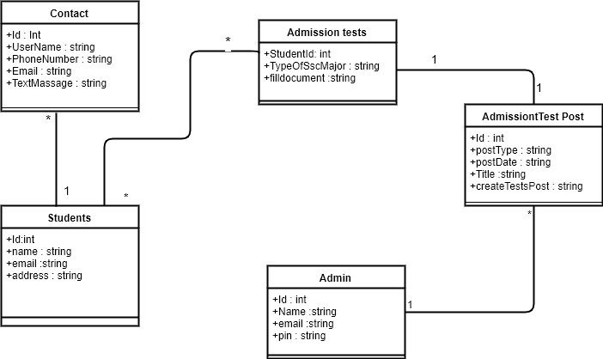
Class diagram

Slide 17
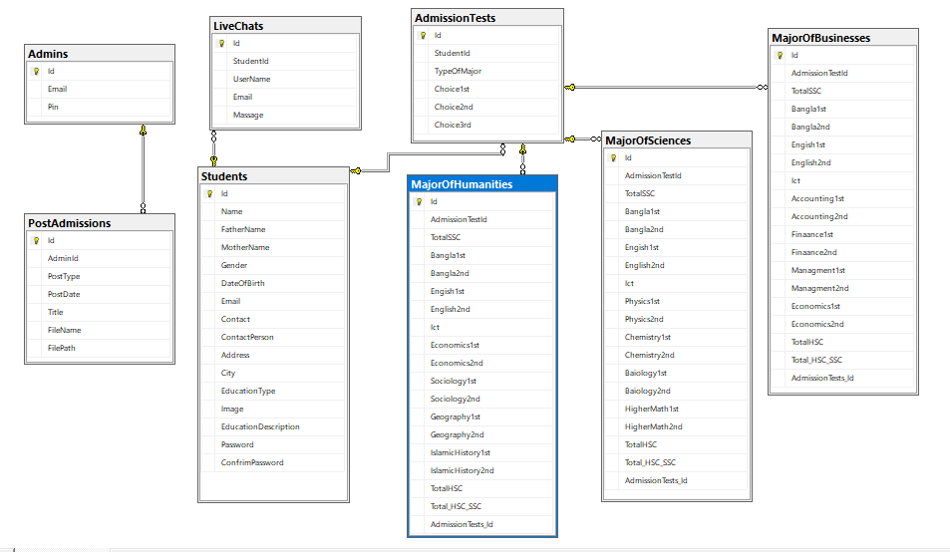
ER- diagram

Slide 18
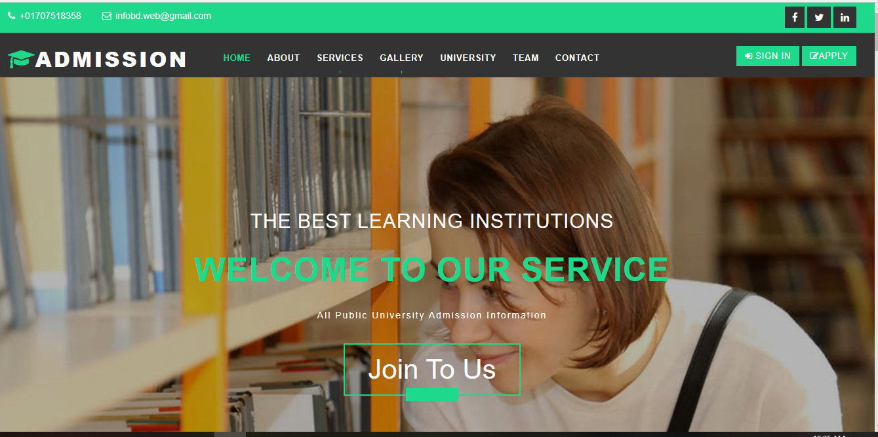
Interface(Screen Short)

Slide 19
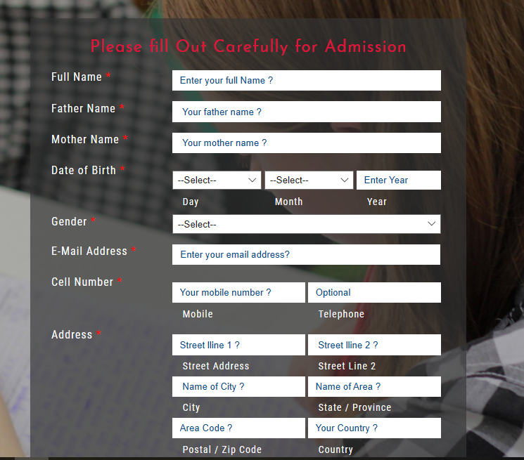
Interface(Screen Short)

Slide 20
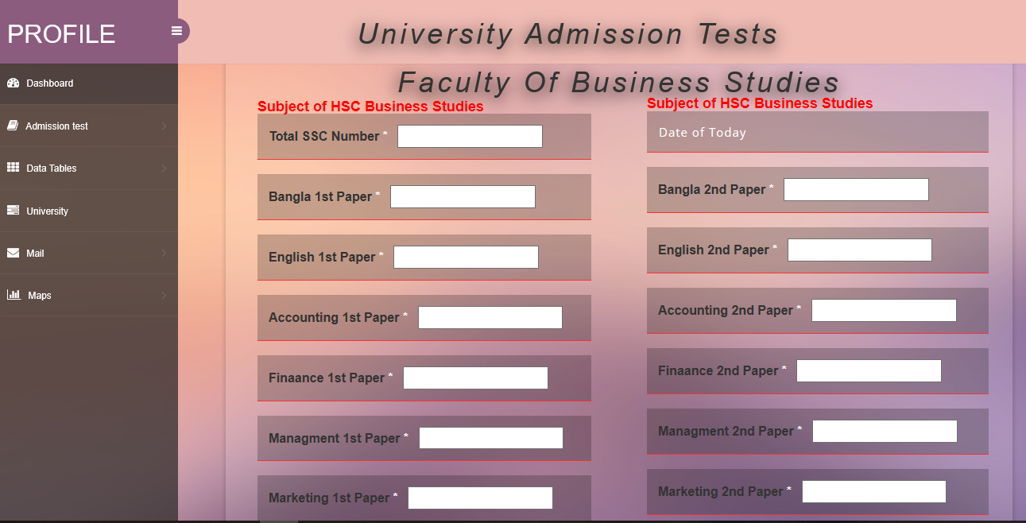
Interface(Screen Short)

Slide 21
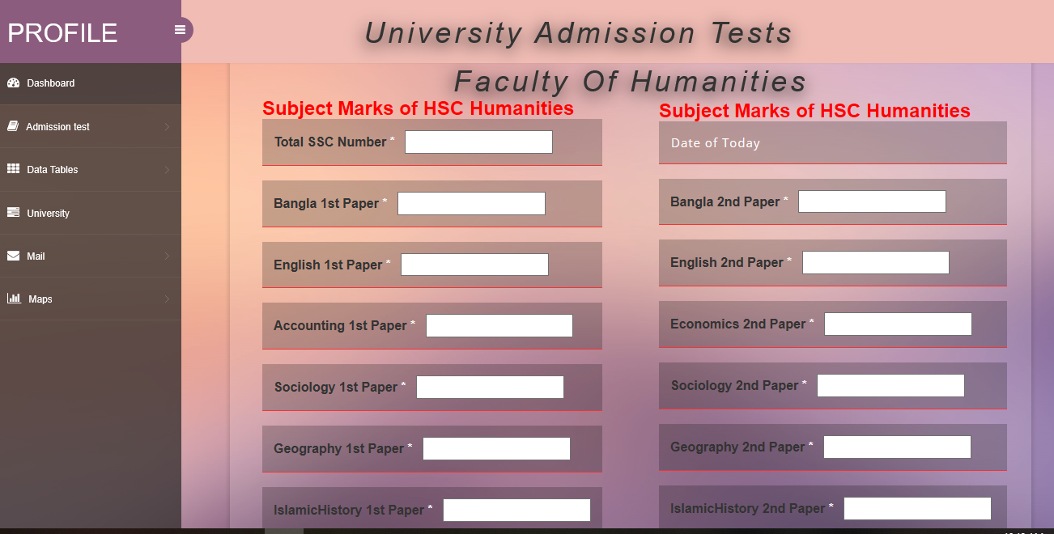
Interface(Screen Short)

Slide 22
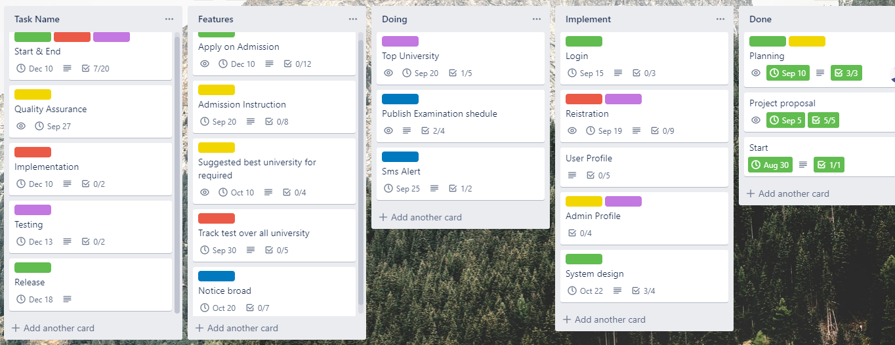
Project Manage

Slide 23
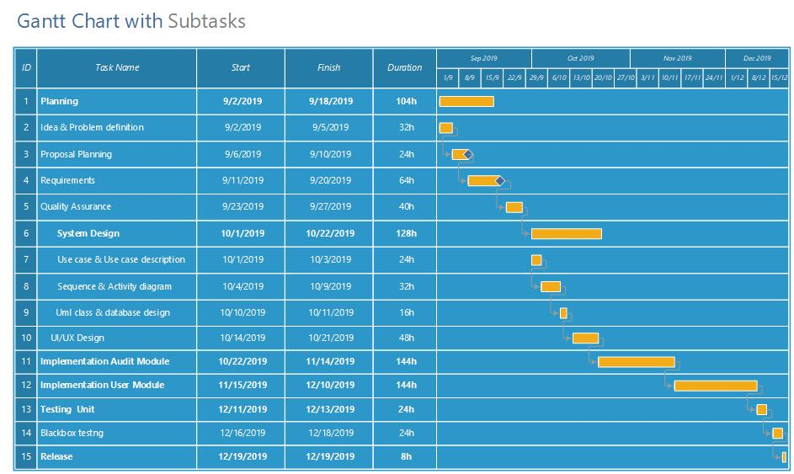
Gantt Chart

Slide 24
Development Tools and Technology
Platform: Web-based
Language: C#
Framework: .NET MVC, Entity Framework
IDE: Visual Studio 2019
Database: SQL Server 2017

